Slide 1
Natural Language Processing-Project
Fine Grained Sentiment Analysis On Financial Microblogs And News Headlines

Slide 2
TEAM MEMBERS
ADITHYAN SUKUMAR (CB.EN.U4AIE19004)
ANIRUDH VADAKKEDATH(CB.EN.U4AIE19008)
ARJUN ANIL (CB.EN.U4AIE19012)
RAJATH RAJESH(CB.EN.U4AIE19051)

Slide 3
CONTENTS
INTRODUCTION
DATASET
LITERATURE REVIEW
WORD EMBEDDINGS
LSTM AND BI-DIRECTIONAL LSTM
RESULTS

Slide 4
Introduction
1

Slide 5
Introduction
Natural Language Processing (NLP) is a branch of Artificial Intelligence (AI) that enables machines to understand human language.
Sentiment analysis in the financial domain has been applied to a wide range of economic and financial fields, such as market prediction, analyzing consumers’ attitudes towards certain brands, or determining the financial blogger’s sentiment towards companies and their stock.
Much of the financial sentiment analysis work has focused on data gathered from financial news. In this project, we have classified financial microblogs and news headlines as positive, neutral, and negative.
Various word embedding technique such as TF-IDF, Word2Vec, Fast text, and Embedding Layer was applied to the dataset. Transformed data were then classified using machine learning models.

Slide 6
Dataset
2

Slide 7
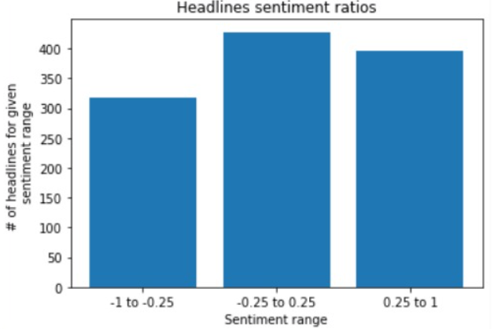
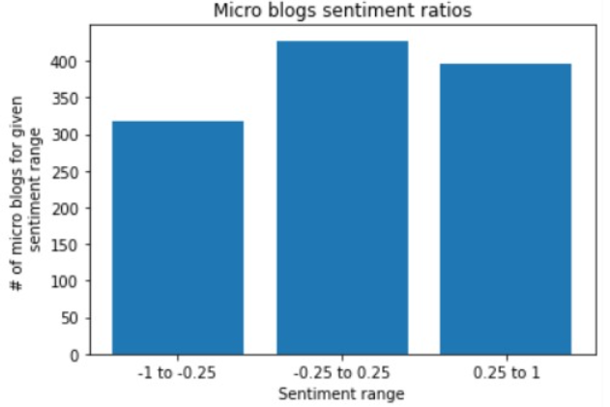
Dataset
Two datasets used for the project was taken from SemEval 2017 Task 5. The first dataset is a collection of 1694 financially relevant microblog messages focusing on stock market events. This messages are either exchanged via the StockTwits microblogging platform or via Twitter. Usually, StockTwits messages contain references to company stock symbols, which are called cashtags. Each message is labeled with a real value denoting the sentiment towards the cashtag.

Slide 8
Literature Review
3

Slide 9
Literature Review
TITLE | AUTHORS | INFERENCE
Fine-grained sen- timent analysis with structural features | Cäcilia Zirn | Used SentiWordNet,Unigram Lexicon to extract polarity features.
Fine-grained sentiment analysis on financial microblogs and news headlines | Mattia Atzeni | BabelNet synsets and Semantic frames were used for the semantic analysis. Achieved an accuracy more than 72%.
Fine- grained sentiment analysis on financial microblogs and news | Chung-Chi Chen | Used 15 available sentiment dictionaries . Achieved an accuracy of 55%.

Slide 10
TITLE | AUTHORS | INFERENCE
Finsentia: sentiment analysis in english financial microblogs | T Gaillat | Extracted financial entities with relevant contexts and assigned scores on a continuous scale. Achieved an F1 score of 0.85
Aspect based fine-grained sentiment analysis for online reviews | Feilong Tang | Used joint aspect-based sentiment topic model,that jointly extracts multi-grained aspects and opinions
Coarse- and fine- grained sentiment analysis of social media text | Clayton R Fink | LS-SVM model was able to get a considerable accuracy with good recall and accuracy.

Slide 11
Word Embedding
4

Slide 12
Word Embedding
It is an approach for representing words and documents. Word Embedding or Word Vector is a numeric vector input that represents a word in a lower-dimensional space. It allows words with similar meanings to have a similar representation.

Slide 13
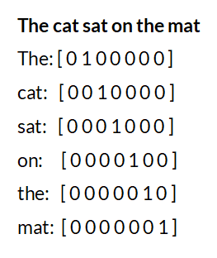
One Hot Encoding
In one hot encoding, every word (even symbols) which are part of the given text data are written in the form of vectors, constituting only of 1 and 0 . So one hot vector is a vector whose elements are only 1 and 0. Each word is written or encoded as one hot vector, with each one hot vector being unique.

Slide 14
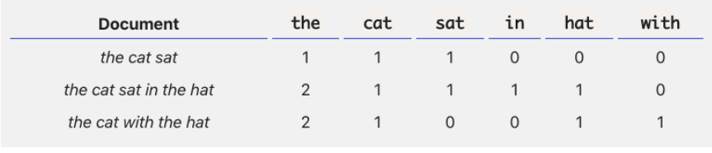
BOW
The bag-of-words (BOW) model is a representation that turns arbitrary text into fixed-length vectors by counting how many times each word appears. This process is often referred to as vectorization.

Slide 15

TF-IDF
TF-IDF - stands for term frequency-inverse document frequency and it is a measure, used in the fields of information retrieval (IR) and machine learning, that can quantify the importance or relevance of string representations (words, phrases, lemmas, etc) in a document amongst a collection of documents (also known as a corpus).
TF-Term frequency works by looking at the frequency of a particular term you are concerned with relative to the document
IDF-Inverse document frequency looks at how common (or uncommon) a word is amongst the corpus.

Slide 16
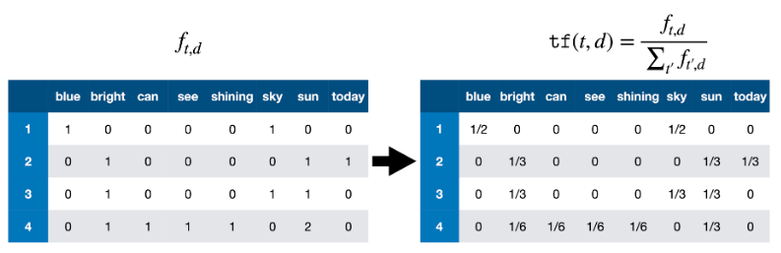
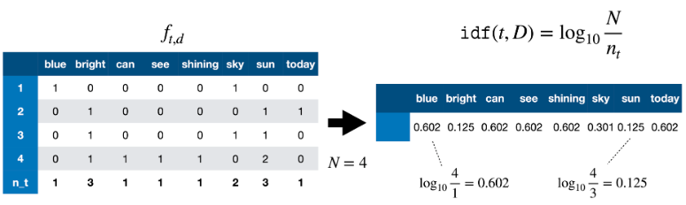

Slide 17
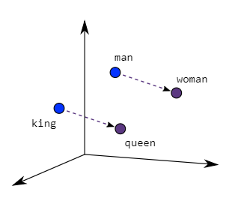
Word2Vec
Word2Vec creates vectors of the words that are distributed numerical representations of word features – these word features could comprise words that represent the context of the individual words present in our vocabulary.
Two different model architectures that can be used by Word2Vec to create the word embeddings are the Continuous Bag of Words (CBOW) model & the Skip-Gram model.

Slide 18
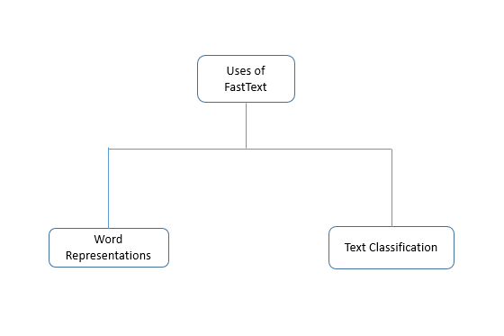
Fast Text
FastText is a library created by the Facebook Research Team for efficient learning of word representations and sentence classification.
FastText differs in the sense that word2vec treat every single word as the smallest unit whose vector representation is to be found but FastText assumes a word to be formed by an n-gram of character.
The vector size is taken as 300 by tuning.

Slide 19
LSTM & Bi-LSTM
5

Slide 20
LSTM
Recurrent Neural Networks suffer from short-term memory. If a sequence is long enough, they’ll have a hard time carrying information from earlier time steps to later ones. So when are trying to process a paragraph of text to do predictions, RNN’s may leave out important information from the beginning.
During back propagation, recurrent neural networks suffer from the vanishing gradient problem. Gradients are values used to update a neural networks weights. The vanishing gradient problem is when the gradient shrinks as it back propagates through time. If a gradient value becomes extremely small, it doesn’t contribute too much learning.

Slide 21
LSTM ’s was created as the solution to short-term memory. They have internal mechanisms called gates that can regulate the flow of information.
An LSTM layer consists of a set of recurrently connected blocks, known as memory blocks.Each one contains one or more recurrently connected memory cells and three multiplicative units - the input, output and forget gates - that provide continuous analogs of write, read and reset operations for the cells.
These gates can learn which data in a sequence is important to keep or throw away. By doing that, it can pass relevant information down the long chain of sequences to make predictions. Almost all state of the art results based on recurrent neural networks are achieved with these two networks.

Slide 22
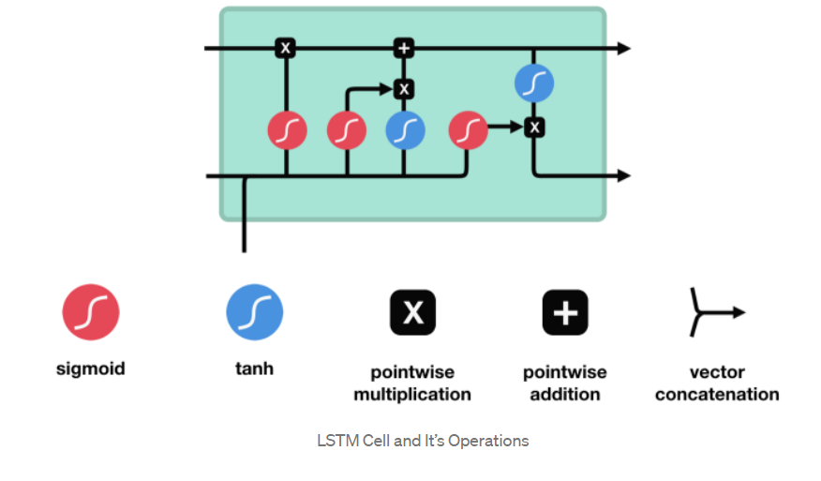

Slide 23
Tanh activation
The tanh activation is used to help regulate the values flowing through the network. The tanh function squishes values to always be between -1 and 1.
Sigmoid
A sigmoid activation is similar to the tanh activation. Instead of squishing values between -1 and 1, it squishes values between 0 and 1. That is helpful to update or forget data because any number getting multiplied by 0 is 0, causing values to disappears or be “forgotten.” Any number multiplied by 1 is the same value therefore that value stay’s the same or is “kept.”

Slide 24
Forget gate
First, we have the forget gate. This gate decides what information should be thrown away or kept. Information from the previous hidden state and information from the current input is passed through the sigmoid function. Values come out between 0 and 1. The closer to 0 means to forget, and the closer to 1 means to keep.
Input Gate
To update the cell state, we have the input gate. First, we pass the previous hidden state and current input into a sigmoid function. That decides which values will be updated by transforming the values to be between 0 and 1. 0 means not important, and 1 means important.
We also pass the hidden state and current input into the tanh function to squish values between -1 and 1 to help regulate the network. Then you multiply the tanh output with the sigmoid output. The sigmoid output will decide which information is important to keep from the tanh output.

Slide 25
Output Gate
Last we have the output gate. The output gate decides what the next hidden state should be. Remember that the hidden state contains information on previous inputs.
The hidden state is also used for predictions. First, we pass the previous hidden state and the current input into a sigmoid function. Then we pass the newly modified cell state to the tanh function.
We multiply the tanh output with the sigmoid output to decide what information the hidden state should carry. The output is the hidden state. The new cell state and the new hidden is then carried over to the next time step.

Slide 26
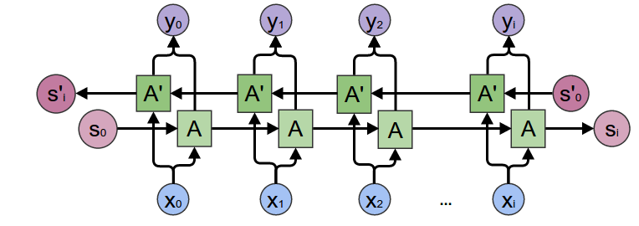
Bi-LSTM
Bidirectional recurrent neural networks(RNN) are really just putting two independent RNNs together. This structure allows the networks to have both backward and forward information about the sequence at every time step
Using bidirectional will run your inputs in two ways, one from past to future and one from future to past and what differs this approach from unidirectional is that in the LSTM that runs backward you preserve information from the future and using the two hidden states combined you are able in any point in time to preserve information from both past and future.

Slide 27
Results
6

Slide 28
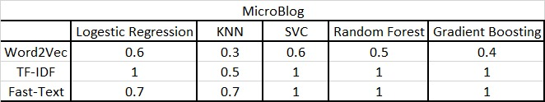
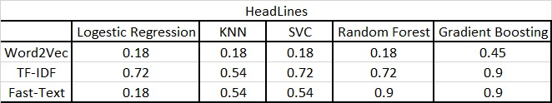
Various embedding methods were tested with numerous Machine Learning(ML) models. The embedding models and ML models used were discussed in the previous sections. Along with ML, Deep Learning (DL) was also used to predict the sentiment. The results are tabulated below.

Slide 29

The models were validated on the provided validation set, and a 10-fold cross validation on Accuracy was done in order to get the following results. It can be seen that Fasttext performs the best of the embedding models while Gradient Boost algorithm classifies the embedded vectors best.
The data was also classified using DL with LSTM and Bi-LSTM and the accuracies are tabulated below.
The headlines as well as microblogs data was first embedded using the tensorflow Embedding and then further classified with LSTM and Bi-LSTM.

Slide 30
CONCLUSION
A comparison on the different embedding techniques on ML and different DL models were done in this work. It could be concluded that when embedding techniques are used, DL assisted models such as Fasttext perform better. This study can be extended to include more embedding and DL and ML models as well.

Slide 31
THANK YOU

Slide 32
Work Split
Anirudh V: Fasttext
Arjun Anil: Word2Vec
Rajath Rajesh: TF-IDF
Adithyan Sukumar: LSTM, Bi-LSTM

